Slide 1
Zoobe Project Manager
Key Features:
Compact Design
Manages Naming Conventions
Manages and creates Project folder structures
Manages asset references
Saves in increments and is able to retrieve previous files if necessary
Able to create master files, flattening all references
Completely built in-house, from the ground up, using only python and mel procedures
No additional external libraries needed, increased stability
Easy installation to all content computers

Slide 2
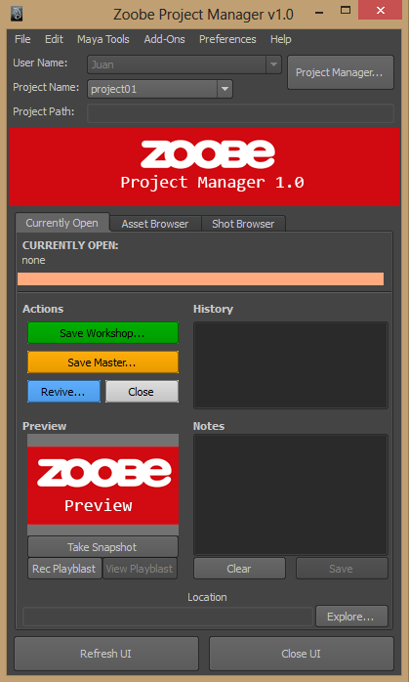
Main UI
Usage: Displays information of currently open asset or shot Can revive previous versions Save 'workshops' as a continuous work in progress Save 'master' files with flattened references Navigate to asset/shot location

Slide 3
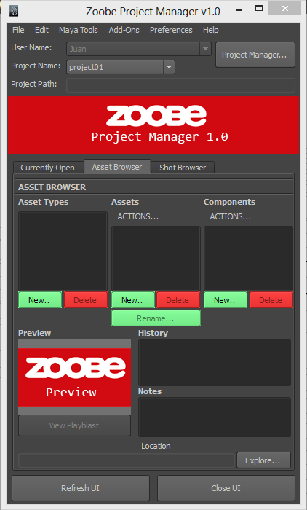
Asset Browser Tab
Still In Development Will Facilitate the following: Creation of assets based on type(model, rig, stage, etc) Manage naming and referencing of assets Display preview of currently selected asset Explore asset directory location Preview playblasts if they exist

Slide 4
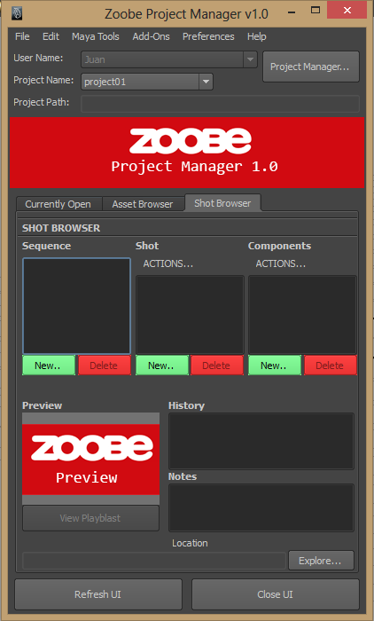
Shot Browser Tab
Still In Development Will Facilitate the following: Creation of animation shots Manage naming and referencing of assets Display preview of currently selected asset Explore asset directory location Preview playblasts if they exist

Slide 5
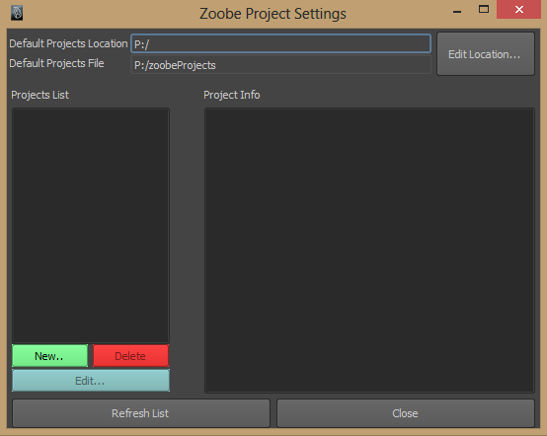
Projects List
At a Glance Project List Quickly view project status Add new projects Edit existing projects

Slide 6
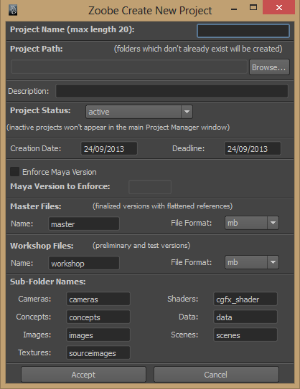
Project Parameters
Streamlined Setup: Create Project Name Specify Project Path Brief description of projects Specify deadlines Enforce Maya Versions Set/Modify project folder names

Slide 7
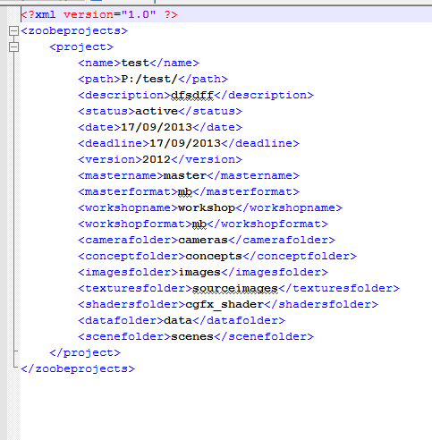
Data saved to XML files

Slide 8
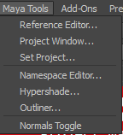
Menu Tools
Ease of Access
Menu Driven expansion of studio tools

Slide 9
Current Status
Things to complete/overcome:
Finalize a working proof of concept
Structuring XML data output and reading options
Minimizing size of data needed to maintain XML files

Slide 10
More to come!
Additional Things to incorporate in the future
Zoobe Ogre Exporter Tools
Zoobe Characterization Tools (Rigging/Mocap)

